Slide 1
In Defense Of Boring
How Charles Darwin’s The Origin of Species Influenced My Project

Slide 2
“According to Darwin’s Origin of Species, it is not the most intellectual of the species that survives; it is not the strongest that survives; but the species that survives is the one that is able best to adapt and adjust to the changing environment in which it finds itself.”
--Leon C. Megginson, Civilization Past and Present, 1963

Slide 3

Inspiration for Design: single cell organisms
Body design that has not changed for 3.5 billion years – UCMP Berkeley
Lives in various extreme conditions such as underwater thermal vents, hot springs, and Antarctica.
To summarize, they look pretty boring to us common folks, as we consider ourselves highly intelligent species that can learn to do C#, JavaScript, HTML, and CSS.
Source: Microbiology Society, 2020 https://microbiologysociety.org/why-microbiology-matters/what-is-microbiology/bacteria.html

Slide 4
BUT!
Simple designs found in Bacteria are robust that allow them to live everywhere and everywhere.
It is my goal of for this project to emulate their survival strategy, hence the simple design of my resume.
Font-family used: Verdana.
Image Optimized photos to summarize my career to my client in three images.
Three highlights of my skills.
The current new skills I am learning
Contact Info
All these parameters were considered when I was designing this resume. A resume simple enough to be able to sell my services to people.
I am assured that my resume can be seen in thick jungles of Amazon, the deepest point of Marianna Trench, and the highest point of Mount Everest.

Slide 5
Struggles Encountered: The time JavaScript made me cried harder than my last breakup.
As I have worked through the assignment. I am confident with my HTML5 and CSS skills. It may not be complex but I believe that I have understood the fundamentals needed in order to survive when I graduate from this course.
However, JavaScript has posed a very challenging language for me to even learn as it was slightly abstract for me to grasp compared to C# (basically I love C# for now).
I realized while doing research for codes online, it came to my realization that there is a lot of bad codes out there.
It is like learning a new language from Google Translate. I have decided to dump the copy and paste strategy as I believe I am continuing to pick up other people’s bad habits.
To summarize: JavaScript is not the easiest for me to grasp. However given enough time, I will be able to master it. Moving forward I prefer learning from the fetus level and grasp the fundamentals and create a code I believe is best for my website. Even at the cost of not reaching the rubric for this assignment.

Slide 6
Discussions
For immediate improvement, I am itching to do is the profanity filter, I believe if I am able to complete the code for it will be a momentous step for me in JavaScript.
Potential improvement on my resume:
Dark mode/light mode.
Implement my design for triangles I have shown you.
Display my portfolio on my website using additional flexbox.
Make a slideshow of my photos (but the rubric said no absolute values. A lot of website out there uses absolute values, there’s none I found that only purely use flexbox)

Slide 7
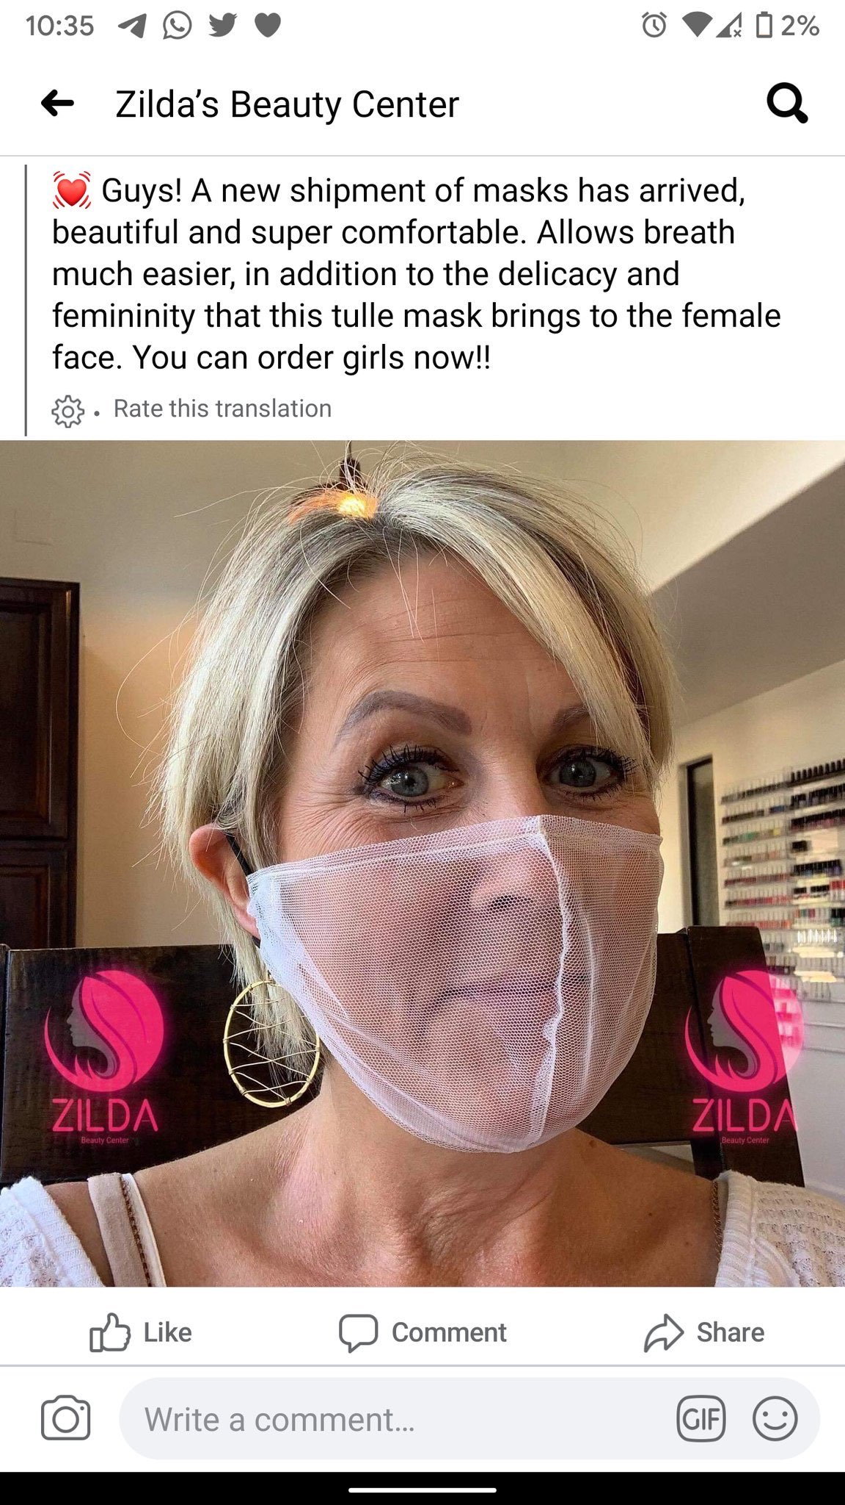
Questions?
If I ever get upset with assignments I always tell myself, “At least I am not selling zero efficacy gauze mask online”. – Jia, July 15, 2020.

